Slide 1

Task 1
Insights:
Taking into account only the work orders where the order date was submitted and received, the average lead time between the request date and completion date is 28.0163

Slide 2
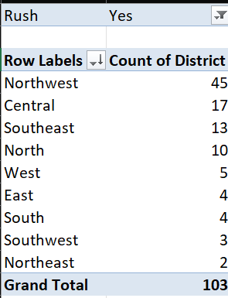
Task 2
Insights:
By filtering the data where the rush jobs equals to a ‘yes’, the district where there is a high amount of rush jobs is Northwest District. The second district of Central is not even a close second as it has only 17 rush jobs.

Slide 3
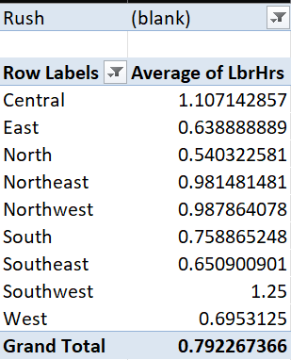
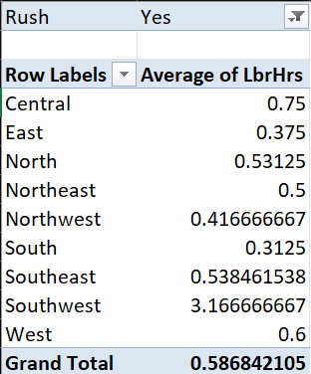
Task 3
Insights:
In the first image, the average labour hours with the exception of rush jobs is calculated as 0.792. The average of labour hours where there are rush jobs is 0.585.
The average labours when there are rush jobs is lower compared to when there are no rush jobs.

Slide 4
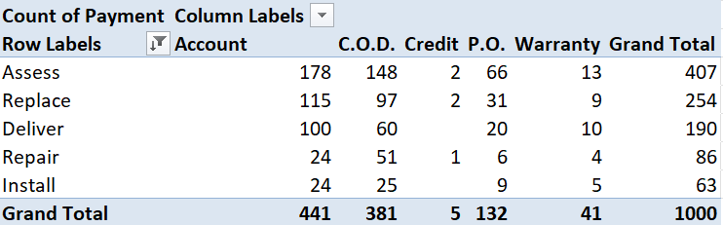
Task 4
Insights:
The distribution of payment types across services is very account dependant. Account payment is the most used payment service with a total of 441 uses whereas credit is the least used payment service with a total of 5 uses.

Slide 5
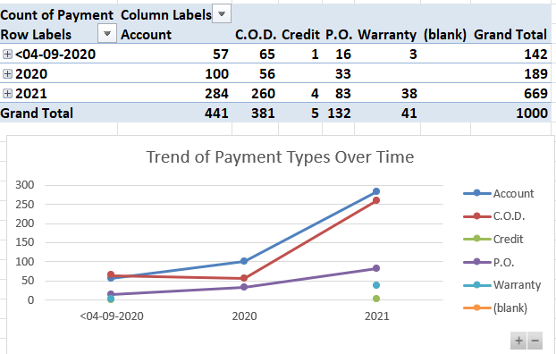
Task 5
Insights:
Yes, with the help of the Line chart we can observe that payment services with Account and C.O.D have skyrocketed after 2020. P.O has seen a slight increase in usage after 2020. Warranty and Credits are the least used payment types over time.

Slide 6

Task 6
Insights:
Using the correl function in excel, there seems to be a negative relationship between Technicians and cost parts. As the number of Technicians increases the Parts Cost increases and then decreases a huge amount.

Slide 7
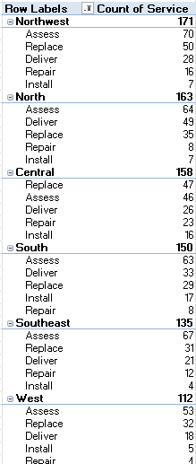
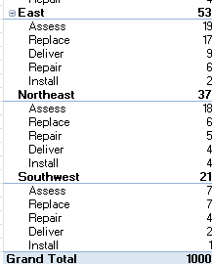
Task 7
Insights:
The most common type of service requested in each district is Assess.
The central district is the only district which demands the replace service when compared to all other districts.

Slide 8


Task 8
Insights:
Yes, there is a difference in payment services when it comes to warranty labours. Warranty labours can only use the warranty payment service while other labours can use different payment services.
Note that the other labours cannot use the warranty payment service

Slide 9
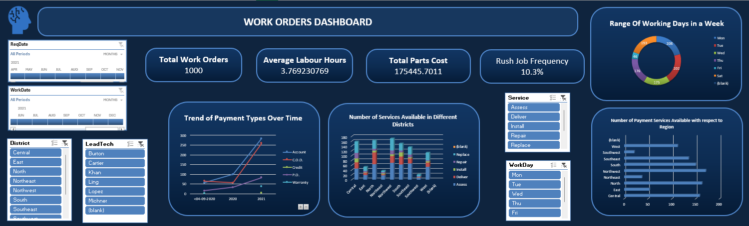
Task 9 - Dashboard

